Slide 1
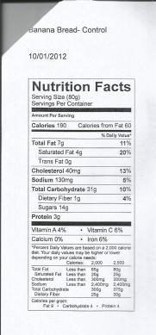
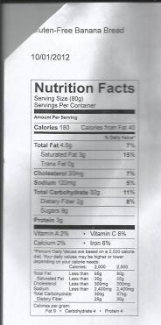
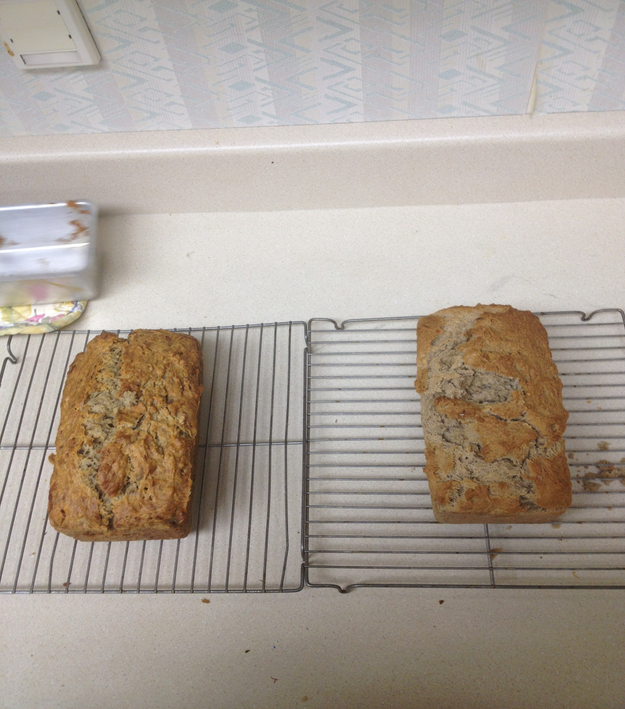
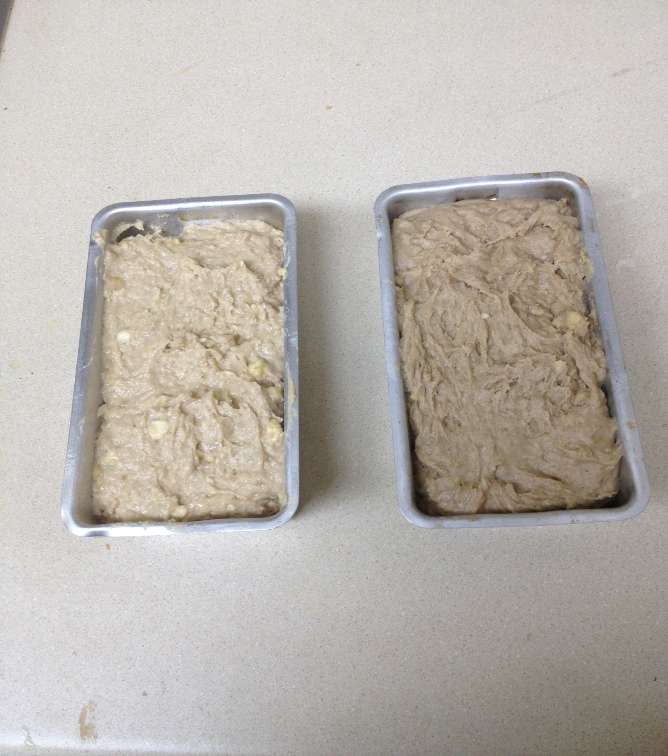
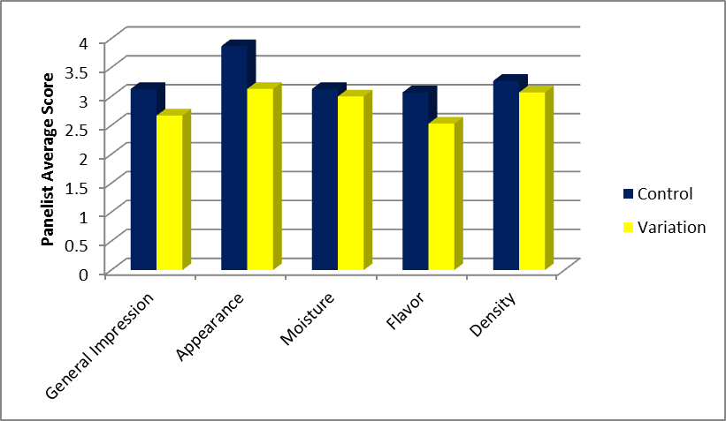
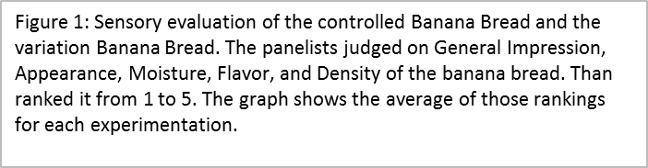
The Effects of Gluten-Free Ingredients on Sensory and Instrumental Evaluations of Banana Bread
By: Katharina Thornton, Courtney Brancazio, Uma Devi Kandasamy, and Maram Murad
Abstract
The purpose of this experiment was to create a gluten-free banana bread recipe. This was achieved by substituting all-purpose flour with brown rice flour. Instrumental evaluations were performed to measure loaf height and volume of loaf. Sensory characteristics were evaluated based on appearance, moisture, flavor, density, and overall likeness. According to the instrumental evaluation results, there was no significant difference in loaf height or loaf volume between the control and gluten-free banana breads. Based on the sensory score card evaluations, the control recipe was preferred over the gluten-free recipe in all areas. While this experiment was successful in creating a gluten-free banana bread recipe, it did not achieve an overall more desirable banana bread recipe.
Control Recipe | Variation Recipe
2 cups all-purpose flour 1 teaspoon baking soda ¼ teaspoon salt ½ cup butter ¾ cup brown sugar 2 eggs, beaten 2 1/3 cups mashed overripe bananas Cooking spray | 2 ½ cups gluten-free brown rice flour ½ teaspoon baking soda 1 ½ baking powder ¼ teaspoon sea salt ½ teaspoon cinnamon 2 eggs, beaten 5 ripe bananas, mashed 1/3 cup brown sugar 1 teaspoon vanilla extract ¼ cup melted coconut oil Cooking spray
Discussion
The gluten free banana bread was not expected to have as great a loaf height as the control banana bread. However, after baking the gluten free banana bread had a loaf height of 9cm, 1cm greater than the control. In a study conducted by European Food Research & Technology, they compared gluten free to wheat, and the wheat had a greater loaf height and overall better quality than the gluten free.7 It is possible that the additives created a better result in the variation than the control recipe yielded. To yield more significant results the specific bread volume could have been calculated, which is done by dividing the bread volume by the bread weight5 instead of doing just length x width x height to get the general volume of the loaf. It is believed that the results could have turned out better than they did. The control recipe had a decent taste, but it should have tasted better. Error could have resulted from human mistakes, such as measuring and baking. The variation had an awful taste as presented in the sensory evaluations. Different additives could have provided a better flavor, such as using a sweeter sugar or different butter. The variation was also very dense and dry in texture. The flour could have caused this, or a shorter baking time may have also alleviated this. There are several other variations and additives that could be used to create a better and more desirable gluten-free banana bread recipe.
Methods
This is gluten-free banana bread; therefore the flour used was gluten-free. Different type of flour was used and some ingredients were added to this variation recipe. The amounts of banana used were almost doubled. However, the baking time and techniques remained the same. The preparation time was 15 minutes, and baking time was 60 minutes. The two types of instrumental evaluations tested were the loft of loaf (loaf height) and the volume of the loaf. The control sample and the gluten-free sample were labeled with the letters BB and a random 3-digit number code to ensure a blind test. Each loaf was cut into bite size pieces and distributed for sampling. Feedback was gathered on general impression, appearance, moisture, flavor, and density based on a 1-5 scale as seen in the sensory evaluation scorecard below. The more preferred recipe was determined based on this feedback.
1) The oven was preheated to 350°F (175°C). Two 9x5 inch loaf pan were greased with cooking spray.2)The batter was prepared according to control recipe and one variation. 3)Flour, baking soda and soda were combined together in a large bowl. Then, using a separate bowl, butter and brown sugar were creamed together. Eggs and mashed bananas were added to this bowl and stirred until well blended. This mixture is then transferred into the flour mixture and stirred to moisten it. The batter is then poured into the greased loaf pan. 4) This batter is then baked for 60 minutes. 5)The breads were ready when the inserted toothpick came out clean. The breads were then cooled for about 10 minutes before it turned out on a wire rack. 6) The breads were cut into 12 slices each, and the instrumental and sensory evaluations were performed.
Conclusion
The purpose of this experiment was to determine the effect on loaf height and volume when all-purpose flour is substituted with brown rice flour to create gluten-free banana bread. The independent variable was the brown rice flour, and the dependent variables were the loaf height and volume. After baking, the control bread height was 8 cm, and the variation height was 9 cm. For both samples, the length was 17 cm and the width was 7.5 cm. To ensure a blind test, the control sample and the gluten-free samples were labeled by the codes: (BB362) for the control banana bread, and (BB362) for the gluten-free banana bread. Feedback was gathered on general impression, appearance, moisture, flavor, and density based on a 1-5 scale as seen in the sensory evaluation. Generally, it was found that the more preferred recipe was the control banana bread based on the class feedback. The effect on a loaf height is slightly higher with brown rice flour than all-purpose flour, and the loaf volume remains the same. Overall, the recipe was successful in creating a gluten-free banana bread with acceptable taste, close in height and volume to the control recipe. Research can continue by trying other instrumental analyses to find more significant difference. Also, experiments can be done using other types of gluten-free substitutes to find something more comparable to the control recipe taste to offer better tasting gluten-free banana bread. Gluten-free research is important in helping those with food allergies, such as celiac disease, live more normal and fulfilled lives.
On the left is the Control banana bread and on the right is the Gluten-free banana bread.
On the left is the control banana bread and on the right is the Gluten-free banana bread

