Slide 1

Social and Ethical Issues Towards Genetically Modified Foods
Presented by: Maram Murad

Slide 2
Did you know that most of our food today that we consume on a daily basis is genetically modified (GM)?

Slide 3
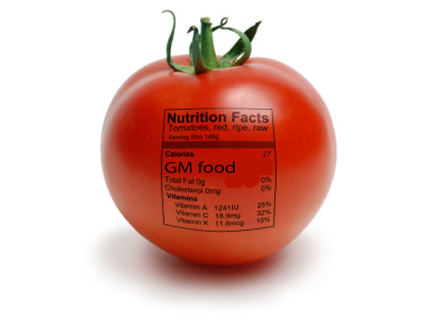
An over view:
Most of the food consumed in the United States is GM, i.e. derived from microorganisms, plants, or animals that have been operated at the molecular level to deliver them with traits that markets or consumers desire.

Slide 4
These foods often are produced using techniques in which foreign genes are inserted into the microorganisms, plants, or animals.
Foreign genes are those taken from sources other than the organism’s natural parents.
Some consumer advocates object to GM foods on ethical grounds, and in such cases they typically have reasons for their disagreement.
USA is the world’s biggest GM crop user.

Slide 5
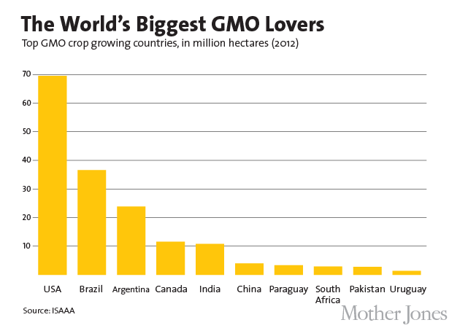

Slide 6
Public attitudes:
Public attitudes about emerging sciences and other new technologies are important factors and determining the successful development and achievement of a technology.
It is necessary to consider public trust in institutions for those concerned with regulatory matters and for those concerned with the strategic development of science.
It is important to develop the best practice in science communication about the risks and benefits of genetically modified food (GMF).

Slide 7
Principles relevant to the evaluation of policies or practices:
Generally, there are main types of principles that are relevant to the evaluation of policies or practices. According to Nuffield Bioethics:
“The first principle is a principle of general welfare, which directs governments and other powerful institutions to promote and protect the interests of citizens.
The second is the maintenance of people’s rights, for example their rights to freedom of choice as consumers.
The third is the principle of justice, and it requires the loads and benefits of policies and practices to be fairly shared among those who are affected by them.”

Slide 8
GM foods and applying the principles of justice:
the problem with GM food is that it is difficult to place within arguments about welfare, rights, and justice.
Some perceive GM crops as unnatural, and those who disapprove of their development and use for this reason are among the strongest critics of GM crops.

Slide 9
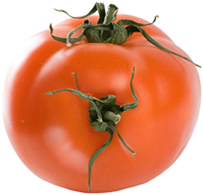
Many have argued that it is unethical to treat nature in such an “industrial fashion,” not simply because of the unfortunate consequences of so doing, but because they believe it is fundamentally wrong.
Whereas the first of these concerns can be accommodated under the principle of the general justice, the second makes the environment an object of ethical concern, regardless of how the environment affects the interests of humans and other animals.

Slide 10
People's attitudes towards GM foods:
In an independent society like the US, many people will not consume foods that they associate with some negative attribute.
Various attributes may contribute to concerns, these include beliefs that there is a possibility for a harmful environmental impact associated with production processes or agricultural practices, and/or opinions that there is an uncertainty associated with human or animal health effects.
Thus, a considerable effort must be directed towards understanding people's attitudes towards GM foods.

Slide 11

People's attitudes and values influence their acceptance or rejection
The customer’s right of being knowledgeable.
    (ex: labeling GM food products).
The insights of risks and benefits associated with particular products.
    (ex: stating possible side effects).

Slide 12
The lack of basic level of food ingredient information in the US:
according to The Center for Food Safety:
    86% of Americans want labels on genetically engineered foods (International Communications Research, March 2000).
    81% of American consumers believe GE food should be labeled. (Time magazine, January 1999).
    58% say that if genetically engineered foods were labeled they would avoid purchasing them. (Time magazine, January 1999).
People want to know what they are eating.

Slide 13
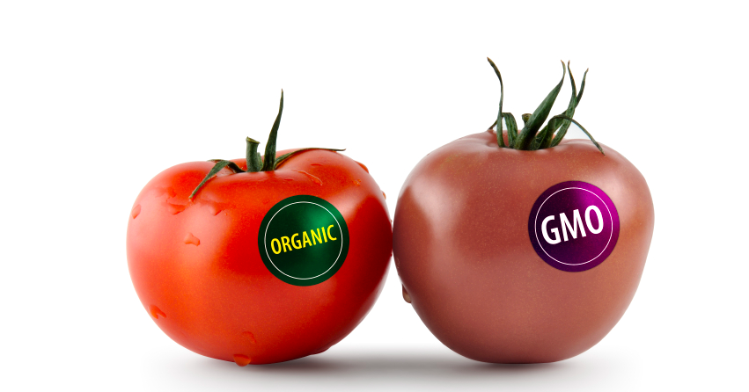
Unlike most other developed countries—such as the 15 nations in the European Union, Japan, Australia, Brazil, Russia and China—the U.S. has no laws requiring labeling of genetically engineered foods.
Currently, the United States has not defined a tolerance level for genetically modified foods.
The feeling of inability of self-control even when making a simple choice, such as food choices!

Slide 14
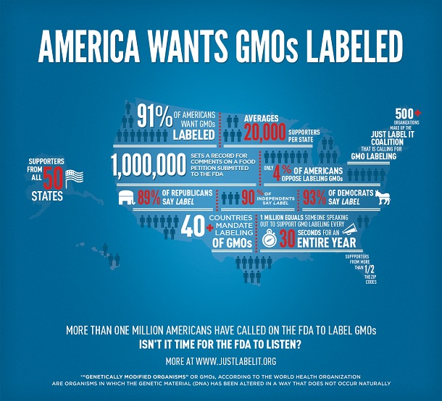

Slide 15
The effects of prior beliefs and learning on consumers’ acceptance of GM foods:
In May 2007, a study was made to see the effects of prior beliefs and learning on consumers’ acceptance of GM foods.
New food products using GM crops appeared in US supermarkets starting in 1996, and consumers’ perceived some risks.
The study was done to examine the role of consumers’ prior beliefs about genetic modification and of diverse, new information on their willingness to pay for foods that might be GM.

Slide 16
Results:
Data were used from economics experiments and show that members who had informed prior beliefs on GM-labeled food products used less than those who had uninformed prior beliefs.
Informed participants were generally not affected significantly by new information.
This study shows that prior beliefs and new information affect bidding behavior of people who participated in this experiment for food items that might be GM.

Slide 17
Discussion: Managing information to achieve private objectives.
Members were examined in their use of prior beliefs and new information to inform decision on willingness to pay for common food items available in grocery stores and supermarkets and not in a lottery.
These results have implications for information policies by showing how both disbelievers and believers of new technologies might try to manage information to achieve private objectives.
This choice is most likely to occur when much is unknown scientifically about the impacts of new technologies or when third-party information is limited or unavailable.

Slide 18
Opponents to a new technology may try to target people who are somewhat uninformed about the technology.
And promoters of the technology may try to target people who have revealing prior beliefs for maximum effectiveness.
Future research might examine the objectiveness of these beliefs and attempt of pro-biotechnology and anti-biotechnology prior beliefs and the way that they affect willingness to buy GM products.

Slide 19
The level of subjective and objective knowledge regarding GM food:
the level of subjective and objective knowledge regarding GM food, among Spanish, European, and US consumers is low. Thus, more information should be provided to consumers to increase both knowledge and understanding of these matters.
The majority of these mentored populations have made little effort to be informed about biotech applications in food production.
The undecided consumers is the segment that shows a high desire for learning more about GM technology in order to assess more clearly their attitudes towards GM food.

Slide 20
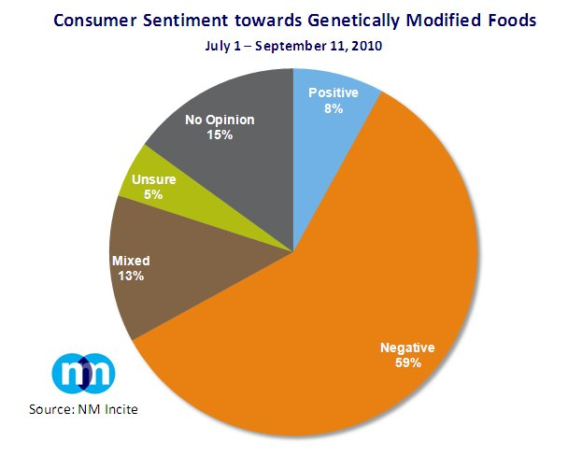

Slide 21

GM crops Approval:
GM crops have met with general approval among scientists and policy makers in the United States, but public approval of GM crops is progressing much more slowly.

Slide 22
Explaining the public resistance to GM food:
In a study explaining public resistance to genetically modiﬁed corn, an economic analysis was shown to determine whether the beneﬁts of one type of GM corn outweigh the potential risks.
It is found that the corn growers, consumers, and industry all beneﬁt from this GM corn adoption, though the purported health and environmental beneﬁts of reducing chemical pesticide usage through the corn are insignificant.

Slide 23
It is important for developing nations to consider, however, not just the risks associated with GM crops, but also potential beneﬁts.
  For example, it was mentioned that this technology could have a far greater impact in the developing world.
  The risks and beneﬁts of these different potential impacts should be weighed when making a decision about adoption of GM crops.

Slide 24
Results:
This study shows how a distributional analysis can inform regulatory decision makers in the much-contested area of GM food.
By considering the beneﬁts and risks to all potential participants, and not just economic efﬁciency, the ﬁndings help explain why large portions of the domestic and international public are worries of GM crops in general.

Slide 25
Thus, it is believed that an underlying cause of public wariness is that consumers do not perceive signiﬁcant beneﬁts to themselves from GM crops, while fearing the slight risks that they might possibly suffer.
Based on this study, if consumer found that GM products would benefit them by directly such as: offering a lower price, better taste, or even longer shelf life they will not stand against it!

Slide 26
Most of what we eat is GM.
The most common GE crops in the United States are soybean, corn, cotton, and canola.
Many processed food products contain soybean or corn ingredients, it’s estimated that 60 to 70 percent of processed foods in grocery stores include at least one GE ingredient.
(e.g., high fructose corn syrup or soy protein),

Slide 27
Currently, The U.S. Food and Drug Administration (FDA) currently requires labeling of GE foods if the food has a significantly different nutritional property; if a new food includes an allergen that consumers would not expect to be present (e.g., a peanut protein in a soybean product); or if a food product contains a toxicant more than acceptable limits.
Recently, in 2001, the FDA proposed optional guidelines for labeling food that does or does not contain GE ingredients.

Slide 28
obligatory labeling connected with GE ingredients is not an easy evaluate:
there are several complex issues that need resolving prior to implementation.
For instance: Labels on GE food imply a warning about health effects, whereas no significant differences between GE and regular foods have been detected.
If a nutritional or allergenic difference were found in a GE food, current FDA regulations require a label to that effect.

Slide 29
Numerous complex conditions will need solving prior implication.
For instance: Product labels about GE meals mean a warning about wellness side effects, while significant differences concerning GE and regular meals are discovered.
If a dietary or allergenic change were being obtained in a GE meal, current FDA laws require a label to that effect.

Slide 30
Consumers who want to buy non-GE food already have an option: to purchase certified organic foods, which by definition cannot be produced with GE ingredients.
Furthermore, consumers who want to avoid animal products need not worry about GE food.
No GE products currently on the market or under review contain animal genes. (However, there is no guarantee that this will not happen in the future).

Slide 31
Labeling GM and Economics:
From an economical point of view, the cost of labeling involves far more than the paper and ink to print the actual label.
Accurate labeling requires a wide identity preservation system from farmer to elevator to grain processor to food manufacturer to dealer.
Estimates of the costs of mandatory labeling vary from a few dollars per person per year to 10 percent of a consumer’s food bill.

Slide 32
Another potential economic impact for certain food manufacturers is that some consumers may avoid foods labeled as containing GE ingredients.
Thus, it is believed that it is unethical to force costumers to pay more for the labeling process costs, while causing a sudden decrease in most markets profits

Slide 33
Survey: Colorado consumers’ attitudes toward GE food products.
Researchers at Colorado State University’s Department of Agricultural and Resource Economics have commenced a sequence of surveys and analyses to understand Colorado consumers’ attitudes toward GE food products.
Their survey found that women of all ages preferred mandatory brands more than adult men, youthful buyers were being unlikely to guide mandatory brands, and those who considered themselves better informed about biotechnology were less concerned that GE foods be labeled.

Slide 34
labels may not be the best way to do so because they are inherently pejorative:
Although providing consumers with information about genetically modified foods is important, labels may not be the best way to do so because they are inherently pejorative.
Food labels were established by the FDA to provide "material information" about a product, such as ingredient and nutrition information, or warnings about a health risk, such as the presence of a potential allergen.

Slide 35
Because genetically modified foods are already scrutinized to ensure that they do not pose new or unique risks, such labels are likely to mislead consumers by implying a warning, and therefore causing an economical loss in the companies earnings.
For the same reason, labels are excluded from regular foods that cause sensitivity or illness in a small fraction of consumers.
For example, though some people may be sensitive to milk due to lactose intolerance, milk is not labeled as such.

Slide 36
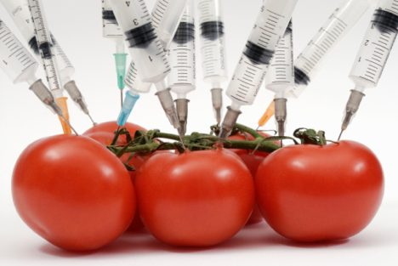
My opinion:
I strongly believe that it is an ethical necessity to label GM products even if it’s a complex process.
As a Nutrition major student, I have to ensure looking at this issue from a health point of view, I learned that it is a US citizen’s right to know what’s in his/her food, and therefore I believe that the government is responsible to pay that extra cost for labeling.

Slide 37
Since many children have developed life-threatening allergies to peanuts and other foods, there is a possibility that introducing a gene into a plant may generate a new allergen or cause an allergic reaction in susceptible persons.
For example, a proposal to incorporate a gene from Brazil nuts into soybeans was abandoned because of the fear of causing unexpected allergic reactions.
A widespread testing of GM foods may be required to avoid the possibility of causing harm to consumers with food allergies.

Slide 38
On the whole, with the exception of possible allergists affects, scientists believe that GM foods do not present a risk to human health. Therefore, GM foods are generally regarded as safe until now.
I consider that each new genetically engineered food should be judged individually.
I personally faound that there has been no adequate testing for GM food products on overall health, and there should be more studies to ensure customers complete safety.

Slide 39
Conclusion:
People must be aware that most of the food consumed in the United States is GM.
Many consumer, including myself, advocates object to GM foods on ethical on nutritional grounds, and in such cases we typically have reasons for our disagreement.
The lack of public informant on GM products results in buying more GM food without even knowing.

Slide 40
It was found that initial attitudes toward biotechnology and GM products have a significant effect on how individuals responded when purchasing food items.
There seem to be strongly influenced by individual values, and thus by subjective knowledge.
It is necessary to consider public trust in institutions for those concerned with regulatory matters and for those concerned with the strategic development of this new science.
It is important to develop the best practice in science communication about the risks and benefits of genetically modified food.

Slide 41
It is important to look at new ways to involve the public openly in the debate about any new technology invention, and to build a relationship between science and society
Many attributes may contribute to concerns, these include beliefs that there is a possibility for a harmful environmental impact associated with production processes or agricultural practices, and/or opinions that there is an uncertainty associated with human or animal health effects.

Slide 42
On the other hand, many studies claim that GM foods are beneficial, and that there no scientific studies that has proven that its harmful.
From an economical point of view, the cost of labeling involves far more than the paper and ink to print the actual label.
Accurate labeling requires a wide identity preservation system from farmer to elevator to grain processor to food manufacturer to dealer.
It is believed that it is unethical to force costumers to pay more for the labeling process costs, while causing a sudden decrease in most markets profits.

Slide 43

Each new genetically engineered food should be judged individually.
When it comes to health, everyone is responsible! And a healthy out side starts from the inside.

Slide 44
References:
Comstock, Gary. Ethics and genetically modified foods (2001)Web.
Frewer, L. (2003). 10. societal issues and public attitudes towards genetically modified foods. Trends in Food Science & Technology, 14(5-8), 319-332.
Nuffield council on bioethics. Genetically modified crops: the ethical and social issues. 2013
Frewer, L. (2003). 10. societal issues and public attitudes towards genetically modified foods. Trends in Food Science & Technology, 14(5-8), 319-332.
The Center for Food Safety. COMPILATION AND ANALYSIS OF PUBLIC OPINION POLLS ON GENETICALLY ENGINEERED (GE) FOODS .UPDATED FEBRUARY 1, 2002.www.centerforfoodsafety.org
Waltz, E. (2009). GM crops: Battlefield. Nature, 461(7260), 27-32. doi: 10.1038/461027a
Center for food safety. GMO Labeling: Label Genetically Engineered Food.2013. <www.gefoodlabels.org>
Wu, Felicia. "Explaining Public Resistance to Genetically Modified Corn: An Analysis of the Distribution of Benefits and Risks." Risk Analysis: An Official Publication Of The Society For Risk Analysis 24.3 (2004): 715-26. Web.

Slide 45
Hossain F, Onyango B, Schilling B, Hallman W, Adelaja A. Product attributes, consumer benefits and public approval of genetically modified foods. International Journal of Consumer Studies. 2003;27(5):353-365. doi: 10.1046/j.1470-6431.2003.00303.x.
P. Bryne, Colorado State University Extension agronomy specialist and professor, soil and crop sciences: Labeling of Genetically Engineered Foods. no 9.3714/02. Reviewed 9/2010.
P. Bryne, Colorado State University Extension agronomy specialist and professor, soil and crop sciences. 4/02. Reviewed 9/2010.
dentification of a Brazil-nut allergen in transgenic soybeans (New England Journal of Medicine, Vol 334, No 11, pp 688-692, 1996)
Effect of diets containing genetically modified potatoes expressing Galanthus nivalis lectin on rat small intestine (Lancet, Vol 354, No 9187, pp 1353-1354, Oct 1999)
Rousu M, Huffman WE, Shogren JF, Tegene A. Are united states consumers tolerant of genetically modified foods? Applied Economic Perspectives and Policy. 2004;26(1):19-31.

